Slide 1
Sorting
Subject : COMP6047
ALGORITHM AND PROGRAMMING
Year : 2019

Slide 2
Learning Outcomes
At the end of this session, student will be able to:
LO 2: Apply syntax and functions in C language in problem
LO 3: Construct a program using C language in problem solving
LO 5: Choose the best sorting and searching algorithm in problem solving

Slide 3
Sub Topics
Sorting:
Bubble Sort
Selection Sort
Insertion Sort
Quick Sort
Merge Sort
Exercise

Slide 4
Sorting
Sorting needs to speed up searching operation in a list.
Sorting type:
Ascending
Descending
Sorting algorithm:
1. Internal sorting
All data to be sorted are loaded to RAM
2. External sorting
Sorting process using secondary storage

Slide 5
Sorting
Simple:
Bubble sort
Selection sort
Insertion sort
Intermediate:
Quick Sort
Merge Sort

Slide 6
Bubble Sort
Compare two neighboring values.
Compare and swap (if necessary)
Also known as exchange sort
Source Code of Bubble Sort:
void Bubble(int *DataArr, int n)
{
int i, j;
for(i=1; i<n; i++)
for(j=n-1; j>=i; j--)
if(DataArr[j-1] > DataArr[j])
Swap(&DataArr[j-1],&DataArr[j]);
}

Slide 7
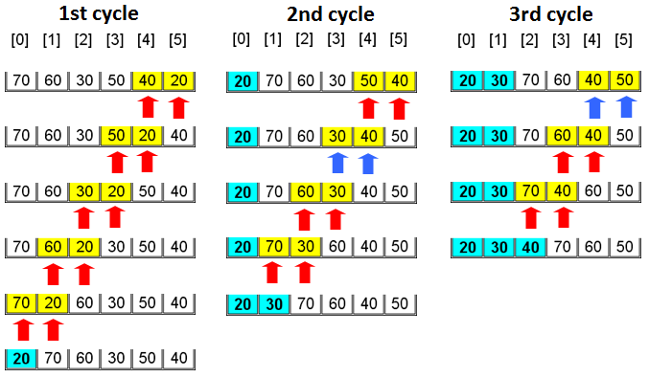
Bubble Sort

Slide 8
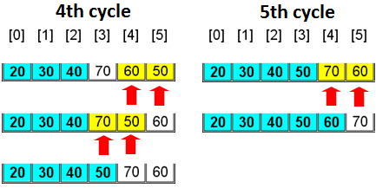
Bubble Sort

Slide 9
Bubble Sort
Previous Bubble sort example has drawback: comparison still performed although all data fully sorted.
To fix this using ‘flag’ that tells if a search round have sorted the data. Also known as Bubble-flag.

Slide 10
Bubble Sort
Source Code of Bubble-Flag
void bubble_Flag(int *Arr, int n)
{
int i, j;
int flag;
flag = 0; i = 1;
while((i < n) && (!flag)){
flag = 1;
for(j=n-1; j>=i; j--){
if(Arr[j-1] > Arr[j]){
Swap(&Arr[j-1], &Arr[j]);
flag = 0;
}
}
i = i + 1;
}
}

Slide 11
Bubble Sort
Source Code of Bubble Sort using RECURSIVE
void swapCompare (int arr[], int a, int n) {
int temp;
if (a < n) {
if (arr[n-1] > arr[n]) {
temp = arr[n-1];
arr[n-1] = arr[n];
arr[n] = temp;
}
swapCompare(arr, a, n-1);
}
}
void bubble_sort(int arr[], int a, int n) {
if (a < n) {
swapCompare(arr, a, n);
bubble_sort(arr, a+1, n);
}
}

Slide 12
Selection Sort
Algorithm:
for(i=0; i<N-1; i++){ /* N=number of data */
Set idx_smallest equal to i
for(j=i+1; j<N; j++){
If array[ j ] < array [ idx_smallest ] then idx_smallest = j
}
Swap array[ i ] with array[ idx_smallest ]
}

Slide 13
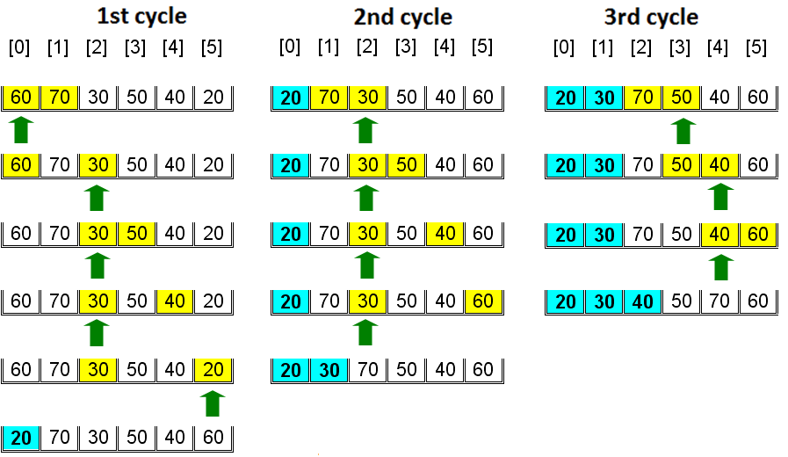
Selection Sort

Slide 14
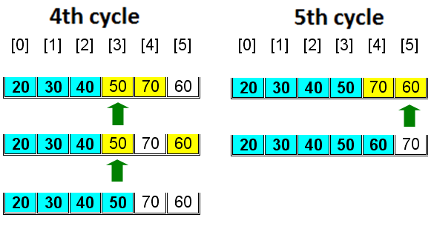
Selection Sort

Slide 15
Selection Sort
Source Code of Selection Sort:
void SelectionSort(int data[], int n)
{
int i, j, idx_low;
for (i = 0; i < n – 1; i++) {
idx_low = i;
for (j = i + 1; j < n; j++)
if (data[idx_low] > data[j]) idx_low = j;
if (idx_low > i) swap(&data[i], &data[idx_low]);
}
}

Slide 16
Insertion Sort
Algorithm:
for(i=1; i<n; i++) {
x = A[i], insert x to its suitable place between A[0] and A[i-1].
}

Slide 17
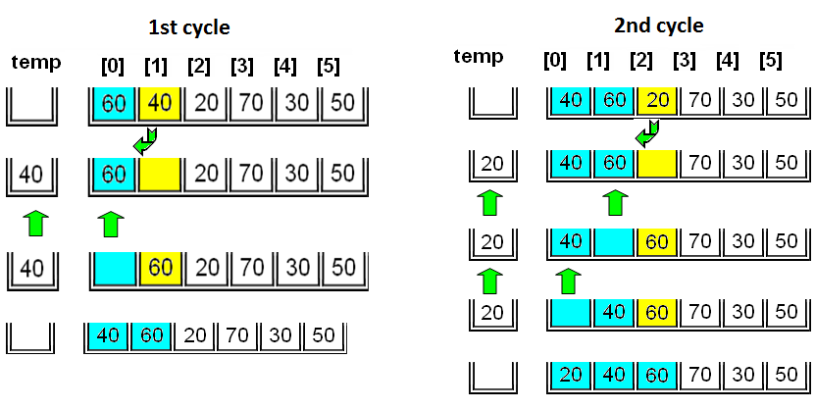
Insertion Sort

Slide 18
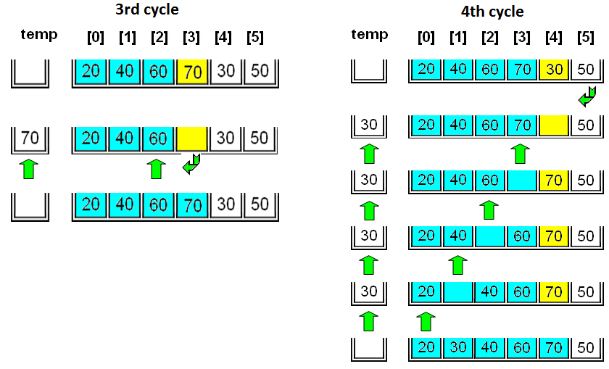
Insertion Sort

Slide 19
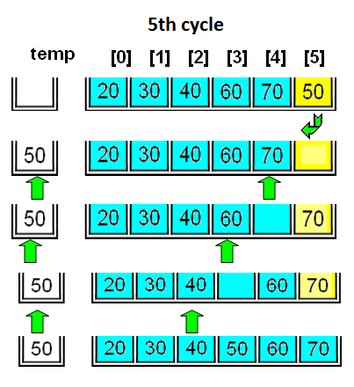
Insertion Sort

Slide 20
Insertion Sort
Source Code of Insertion Sort:
void Insertion(int *Arr, int n){
int i, k, y;
for(k=1; k < n; k++) {
y = Arr[k];
for(i=k-1; i >= 0 && y < Arr[i]; i--)
Arr[i+1] = Arr[i];
Arr[i+1] = y;
}
}

Slide 21
Quick Sort
Algorithm:
void QuickSort(int left, int right)
{
if(left < right){
//arrange elements R[left],...,R[right] that
//producing new sequence:
R[left],...,R[J-1] < R[J] and R[J+1],...,R[right] > R[J].
QuickSort(left, J-1);
QuickSort(J+1, right);
}
}

Slide 22
Quick Sort
Element movement in quick sort (1)
R[0]
R[1]
R[2]
R[3]
R[4]
R[5]
R[6]
R[7]
R[8]
QS(0,8)
73
79
76
72
75
78
71
77
74
J = 1
K = 6
SWAP
R[0]
R[1]
R[2]
R[3]
R[4]
R[5]
R[6]
R[7]
R[8]
73
71
76
72
75
78
79
77
74
J = 2
K = 3
SWAP

Slide 23
Quick Sort
Element movement in quick sort (2)
R[0]
R[1]
R[2]
R[3]
R[4]
R[5]
R[6]
R[7]
R[8]
73
71
72
76
75
78
79
77
74
K = 2
SWAP
J = 3
R[0]
R[1]
R[2]
R[3]
R[4]
R[5]
R[6]
R[7]
R[8]
73
71
72
76
75
78
79
77
74
K = 2
SWAP
J = 3

Slide 24
Quick Sort
Element movement in quick sort (3)
R[0]
R[1]
R[2]
R[3]
R[4]
R[5]
R[6]
R[7]
R[8]
71
72
73
76
75
78
79
77
74
QS(0,0)
QS(2,1)
R[0]
R[1]
R[2]
R[3]
R[4]
R[5]
R[6]
R[7]
R[8]
71
72
73
76
75
78
79
77
74
QS(3,8)
J = 5
SWAP
K = 8

Slide 25
Quick Sort
Element movement in quick sort (4)
R[0]
R[1]
R[2]
R[3]
R[4]
R[5]
R[6]
R[7]
R[8]
71
72
73
76
75
74
79
77
78
K = 5
J = 6
SWAP
R[0]
R[1]
R[2]
R[3]
R[4]
R[5]
R[6]
R[7]
R[8]
QS(3,4)
71
72
73
74
75
76
79
77
78
QS(3,2)
QS(4,4)

Slide 26
Quick Sort
Element movement in quick sort (5)
R[0]
R[1]
R[2]
R[3]
R[4]
R[5]
R[6]
R[7]
R[8]
71
72
73
74
75
76
79
77
78
QS(6,8)
K = 8
J = ?
SWAP
R[0]
R[1]
R[2]
R[3]
R[4]
R[5]
R[6]
R[7]
R[8]
71
72
73
74
75
76
78
77
79
QS(6,7)
K = 7
J = 8
SWAP

Slide 27
Quick Sort
Element movement in quick sort (6)
R[0]
R[1]
R[2]
R[3]
R[4]
R[5]
R[6]
R[7]
R[8]
71
72
73
74
75
76
77
78
79
QS(6,6)
R[0]
R[1]
R[2]
R[3]
R[4]
R[5]
R[6]
R[7]
R[8]
QS(8,7)
71
72
73
74
75
76
77
78
79
QS(9,8)

Slide 28
Quick Sort
Quick Sort execution schema:
(left, right) recursively
QS(0,8)
QS(0,1)
QS(3,8)
QS(0,0)
QS(2,1)
QS(3,4)
QS(6,8)
QS(3,2)
QS(4,4)
QS(6,7)
QS(9,8)
QS(6,6)
QS(8,7)

Slide 29
Quick Sort
Source Code of Quick Sort:
void QuickSort(int L,int R) {
int j,k;
if(L < R){
j = L; k = R + 1;
do{
do{ j=j+1;} while(Arr[j] < Arr[L]);
do{ k=k-1;} while(Arr[k] > Arr[L]);
if(j < k) Swap(&Arr[j],&Arr[k]);
}while(j <= k);
Swap(&Arr[L],&Arr[k]);
QuickSort(L,k-1);
QuickSort(k+1,R);
}
}
Try to create swap function!

Slide 30
Merge Sort
Merge Sort is a sorting algorithm based on the divide-and-conquer algorithm
Divide-and-conquer is a general algorithm design paradigm
Divide: divide the input data in two disjoint subsets
Recur: solve the sub problems associated with subsets
Conquer: combine the solutions for each subset into a solution

Slide 31
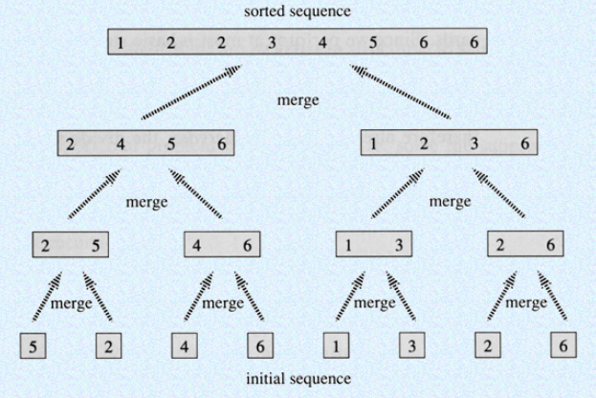
Merge Sort

Slide 32
Merge Sort
Source Code of Merge Sort:
void merge( int arr[], int L, int m1, int m2, int R )
{
int Lidx = L;
int Ridx = m2;
int Cidx = L;
int temparr[ SIZE ];
int i;
while ( Lidx <= m1 && Ridx <= R ) {
if ( arr[ Lidx ] <= arr[ Ridx ] )
temparr[ Cidx++ ] = arr[ Lidx++ ];
else
temparr[ Cidx++ ] = arr[ Ridx++ ];
}
Notes:
L is Left, R is Right, idx is index, m1 is Mid1, m2 is Mid2, C is Combined, arr is array, SIZE is size of array

Slide 33
Merge Sort
Source Code of Merge Sort:
if ( Lidx == m2 ) {
while ( Ridx <= R )
temparr[ Cidx++ ] = arr[ Ridx++ ];
}
else {
while ( Lidx <= m1 )
temparr[ Cidx++ ] = arr[ Lidx++ ];
}
for ( i=L; i<=R; i++ )
arr[ i ] = temparr[ i ];
}
Notes:
L is Left, R is Right, idx is index, m1 is Mid1, m2 is Mid2, C is Combined, arr is array, SIZE is size of array

Slide 34
Merge Sort
Source Code of Merge Sort:
void mergeSort( int arr[], int low, int high )
{
int m1, m2;
if ( ( high-low ) >= 1 ) {
m1 = ( low+high ) / 2;
m2 = m1+1;
mergeSort( arr, low, m1 );
mergeSort( arr, m2, high );
merge( arr, low, m1, m2, high );
}
}
Notes:
L is Left, R is Right, idx is index, m1 is Mid1, m2 is Mid2, C is Combined, arr is array, SIZE is size of array

Slide 35
Exercise
Sort by ascending to the following data, and simulate its sequence each round using bubble, selection and insertion sort:
14 6 23 18 7 47 2 83 16 38
By ascending, sort the following data using:
Quick sort
Merge sort
Draw its execution schema
14 6 23 18 7 47 2 83 16 38

Slide 36
Exercise
Create a program/function to sort 10 data string save in an array of string (ascending), using algorithm :
Bubble sort
Data :
Ali Ani Tono Bayu Amir Ani Budi Tini Ucok Paijo

Slide 37
Exercise
Create a function/program to sort 10 data struct mhs saved in array of structure, using selection sort.
Sort is based on gpa (ascending), for similar gpa then sort by name (ascending).
struct mhs{
int nim;
float gpa;
char name[20];
};

Slide 38
Summary
Sorting type:
Ascending
Descending
Simple sorting algorithms:
Bubble sort
Selection sort
Insertion sort
Intermediate sorting algorithms:
Quick Sort
Merge Sort

Slide 39
References
Paul Deitel & Harvey Deitel. (2016). C how to program : with an introduction to C++. 08. Pearson Education. Hoboken. ISBN: 9780133976892. Chapter 6 & 7
Sorting Algorithm Animations: http://www.sorting-algorithms.com/
Sorting Algorithms: http://www.youtube.com/watch?v=INHF_5RIxTE

Slide 40
END

